Slide 1
RANDOM
FOREST

Slide 2
RANDOM FOREST
1.Random Forest is an ensemble learning method based on
Decision Tree.
2.It builds many decision tree and merges their outputs (by Voting
or averaging) to make the final predictions.
3.works for both classification and regression tasks
Simple eg,
ask ⟶ one friend ⟶ if a movie is good? ⟶ may get a wrong answer
ask ⟶ 10 friends ⟶ go with majority opinions ⟶ much better chance
of making right decisions

Slide 3
ENSEMBLE LEARNING
It is a technique where multiple models(called learners)are
combined to solve a problem and improve performance.
WHY ENSEMBLE:
increase accuracy reduces error and overfitting make predictions more robust and stable

Slide 4
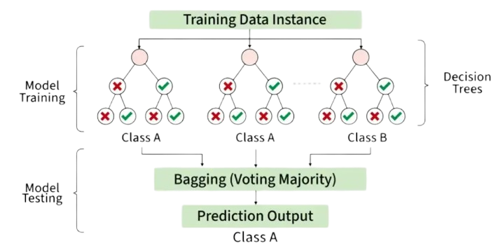

Slide 5
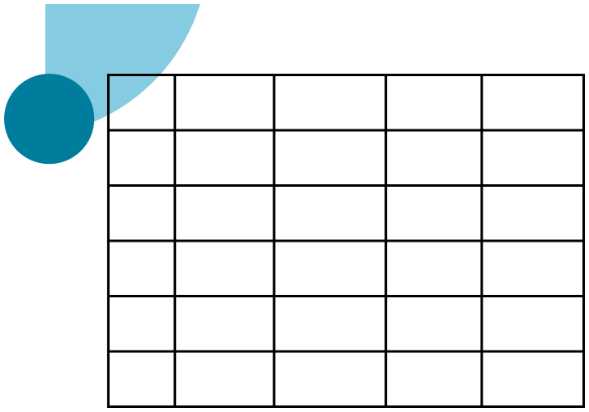

RANDOM FOREST EXAMPLE
Income
Weekend
Hungry
Will Buy
Age
Tree: 2 (different data + random features) Chosen feature: [Income, Weekend, Hungry] Root split on: Weekend
25
High
Yes
Yes
Yes
35
Low
No
No
No
if Yes ⟶ Predict Yes if No ⟶ Split on Hungry
30
Medium
Yes
No
No
if Yes ⟶ predict Yes if No ⟶ Predict No
45
High
No
Yes
Yes
28
Low
Yes
Yes
Yes
Tree: 3 (different data + random features): Chosen features: [Age, Income, Hungry] Root Split on: Income
Random Forest with 3 Tree examples: Tree: 1 (random data + random features) Chosen feature: [Hungry, Age, Weekend] Root split on: Hungry if Yes ⟶ Predict Yes if No ⟶ Predict No
if High ⟶ Predict Yes if Medium or low ---> Predict No

Slide 6
HOW PREDICTION WORKS
For new data point (input data / test data) Age = 30, Income = High, weekend = Yes, Hungry = Yes Tree 1 → Yes (Hungry = Yes) Tree 2 ⟶ Yes (Weekend = Yes) Tree 3 ⟶ Yes (Income = High) Final Prediction ⟶ Yes (Majority Vote)

